Slide 1


The past, present and future of Circular Economy
Andrea Genovese

Slide 2
Outline
The Linear Economy
  The inevitability of waste in a capitalist system
What is a Circular Economy?
Who pushes for a Circular Economy?
  The apolitical and eco-modernist version of CE
  Alternative CE Futures
CE Futures, Value and Supply Chains
Conclusions

Slide 3

The Linear Economy
  Producing goods by combining:
    Means of production (fixed capital), which, when obsolete, must be replaced (reproduced), in such a way to provide a competitive advantage;
    Labour, which must also be reproduced (the workers must be housed, fed, trained, and kept healthy)
    Natural resources (for a long time, seen as free)

Slide 4
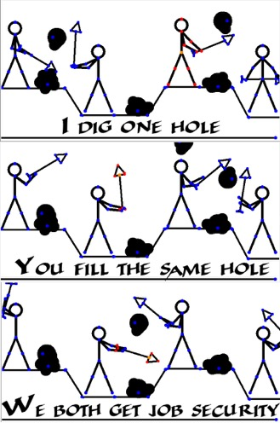
The Linear Economy
“I should support at the same time all sorts of policies for increasing the propensity to consume. For it is unlikely that full employment can be maintained, whatever we may do about investment, with the existing propensity to consume.”
John Maynard Keynes (1936)
“Our enormously productive economy … demands that we make consumption our way of life, that we convert the buying and use of goods into rituals, that we seek our spiritual satisfaction, our ego satisfaction, in consumption … we need things consumed, burned up, replaced and discarded at an ever-accelerating rate.”
Victor Lebow (1955)

Slide 5
Capitalism needs waste
M-C-M’ cycle
  Capitalism requires the “the quick disappearance of commodities from the sphere of circulation, and their equally quick replacement by fresh commodities” (Marx 1867, 217)
  “The velocity of circulation of money is merely a reflection of the rapidity with which commodities change their forms” Marx (1867, 217)

Slide 6
Capitalism needs waste
Tendency of the Rate of Profit to Fall
  Workers’ demands
  Diffusion of technology
  Saturation of consumption
Emergence of a Metabolic Rift
  In the interaction between humanity and the rest of nature
  Marx (1867, 1894)
Outsourcing and Offshoring
Faux Innovation
Planned Obsolescence

Slide 7
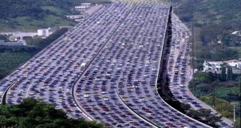
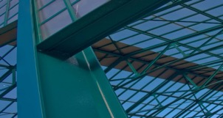

What about Efficiency?
MOBILITY
BUILT ENVIRONMENT
FOOD
  Cars remain parked 92% of the time
  When moving, they usually carry 1.5 people at a time
  1.5m lives are lost in accidents yearly worldwide
  30% of waste sent to landfill in Europe originates from construction
  Offices are occupied only 40-50% of the day on a working day (pre-Covid)
  11 million empty homes in Europe
  >100M tonnes of food lost annually in Europe
  50% lost along the production chain
  97% of global food residue is sent to landfill
  Huge Soil degradation
SOURCE: “Growth Within: A Circular Economy Vision for a Competitive Europe”, Ellen MacArthur Foundation, SUN (Stiftungsfonds für Umweltökonomie und Nachhaltigkeit) and McKinsey Center for Business and Environment, 2015

Slide 8
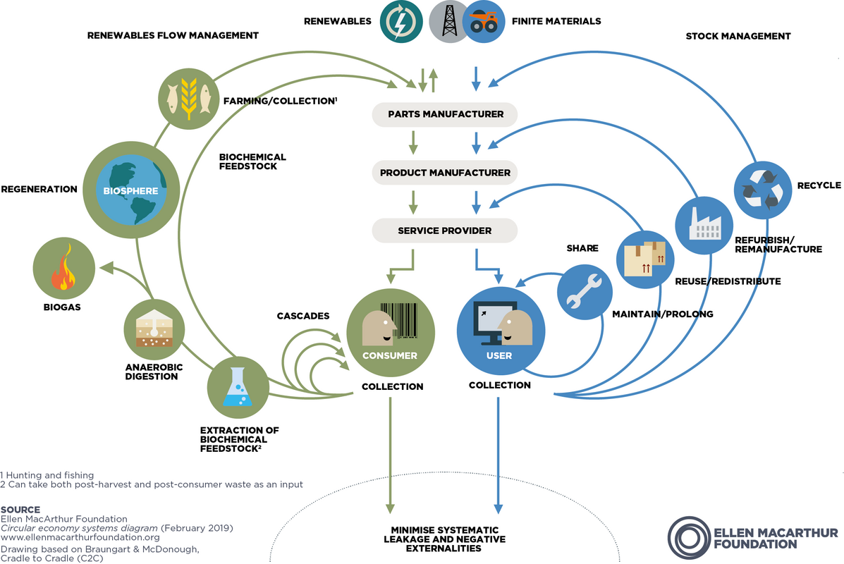
Circular Economy

Slide 9
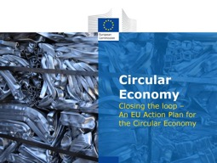


From the 3Rs to the 10Rs?
Reduce
Reduce (?)
Reuse
Refuse
Recycle
Rethink
3Rs
Reuse
Repair
Refurbish
Remanufacture
Repurpose
Recycle
10Rs

Slide 10
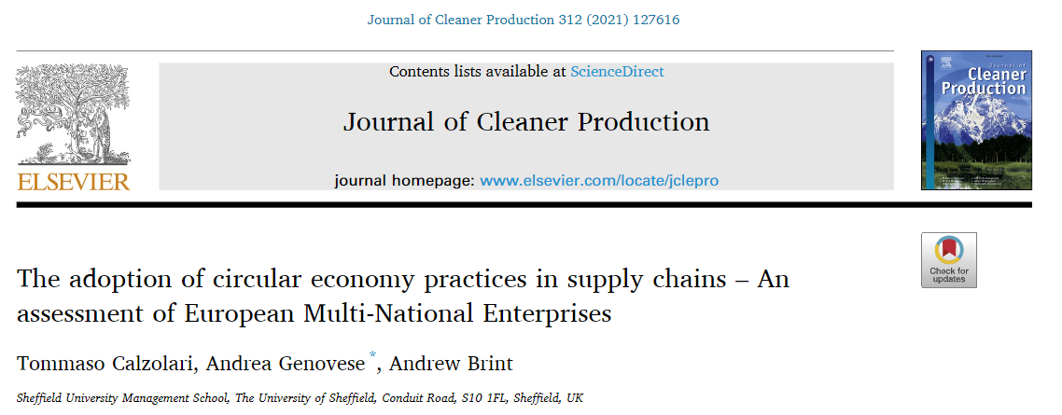
Circular Reductionism?
“Results confirm that the prevalent approaches so far have had a reductionist interpretation of the CE concept, where reduce and reuse actions (which are linked to deeper revisions of business models) are still avoided, as they could compromise economic growth through ever-growing outputs or affect the release of new products (e.g. manufacturing easy to repair products might cannibalise future sales).
This would confirm that despite strong societal pressures, companies seem to face a linear lock-in re-thinking deeply how value is created”

Slide 11
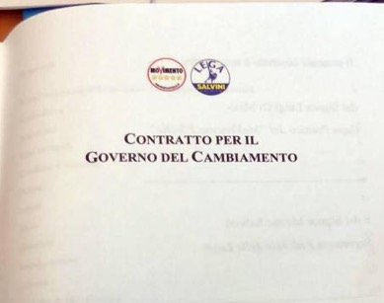
Is this CE desirable?
"It is necessary that every intervention of the political decision-maker is part of a circular economy strategy, understood as an environmental and economic system in which an asset is used, it becomes waste, and then, downstream of a recovery process, it ceases to be such for be reused as a secondary material for the production of a new good, as opposed to the "linear economy" model in which the goods that have become waste are simply sent for disposal after their use."
2018 Government Agreement M5S-Lega
Chapter 4: Environment, Green Economy and Waste Management

Slide 12
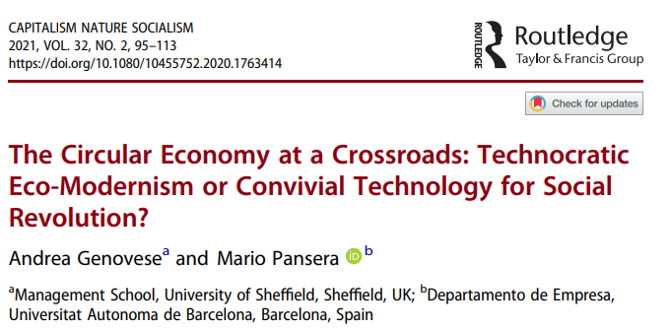
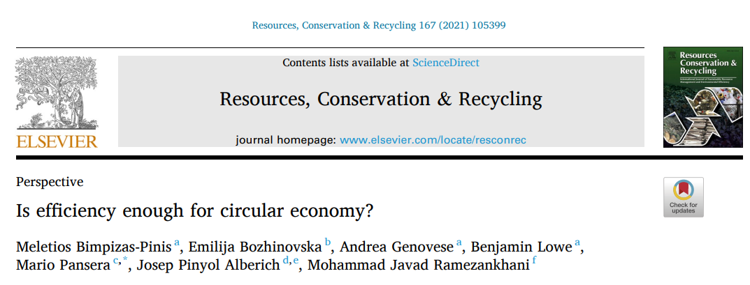
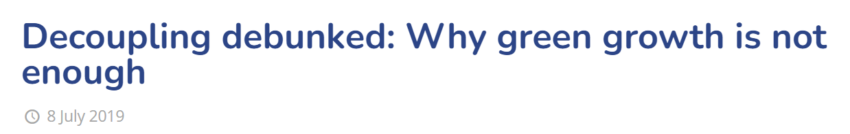
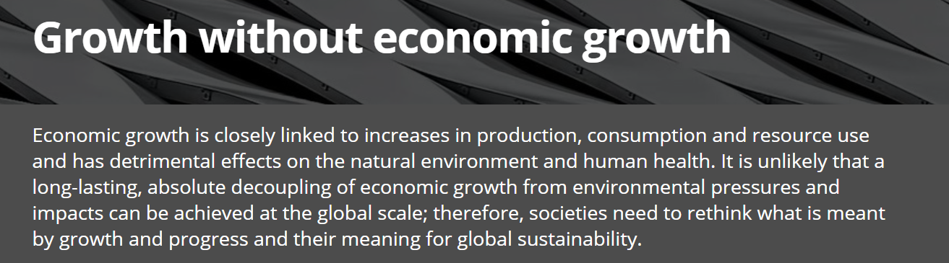
Is this CE desirable?
The CE discourse conveyed by the EU and by large MNEs avoids some fundamental questions:
  Who decides what to produce, why to produce, how to produce?
  Who wins? Who loses? What impact on class relations?
  CE within a growth-oriented (but austerity-driven) framework
    Maastricht treaty; ESM – relaxed for now, but then?
    What about the impossibility of decoupling?

Slide 13
Circular Modernism
Technology will save us
The market will take care of it! No need for planning
No political transformation is required!
Win – win solutions
No worries! Keep on growing!

Slide 14
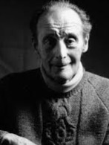


An alternative framing for CE
“Convivial tools” are tools* which can empower users, give them the opportunity to self-learn and keep the balance between self and ready-made work, and between human activities and the biosphere (Illich, 1973; Gorz, 1980)
Conviviality as opposed to Industrial Productivity
Radically rethinking Labour and the hierarchical organisation of production
Supply networks of “liberated” factories

Slide 15
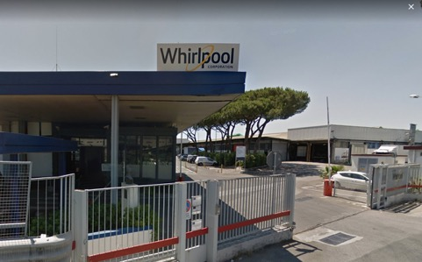

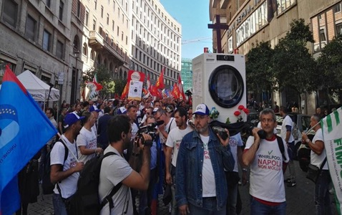
Practical Examples
How do we deal with industrial crises?
Could they be a way to implement Convivial CE production practices?

Slide 16
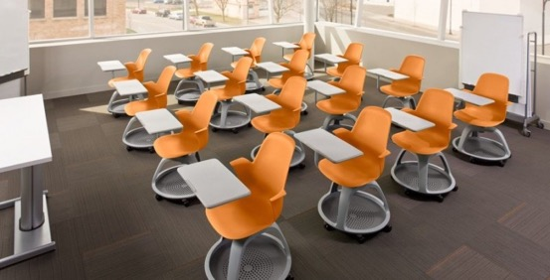
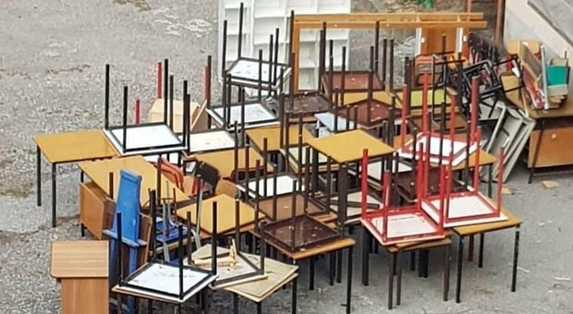
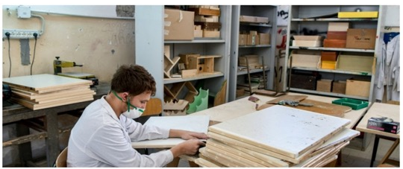
Practical Examples (2)
Top-Down linear solutions
To comply with Covid-19 physical distancing regulations, Italian schools needed to replace two-seater desks
Bottom-up convivial circular solutions

Slide 17
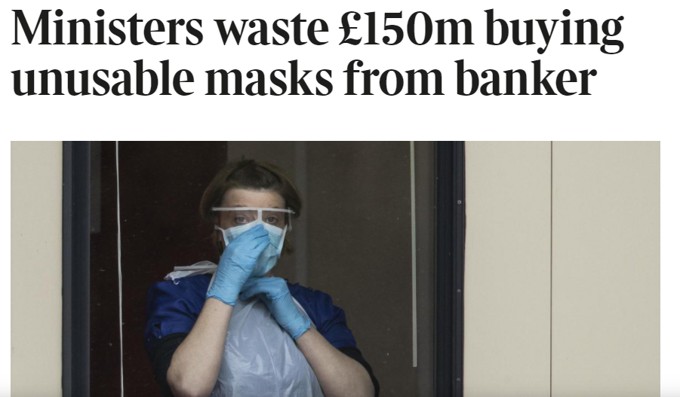
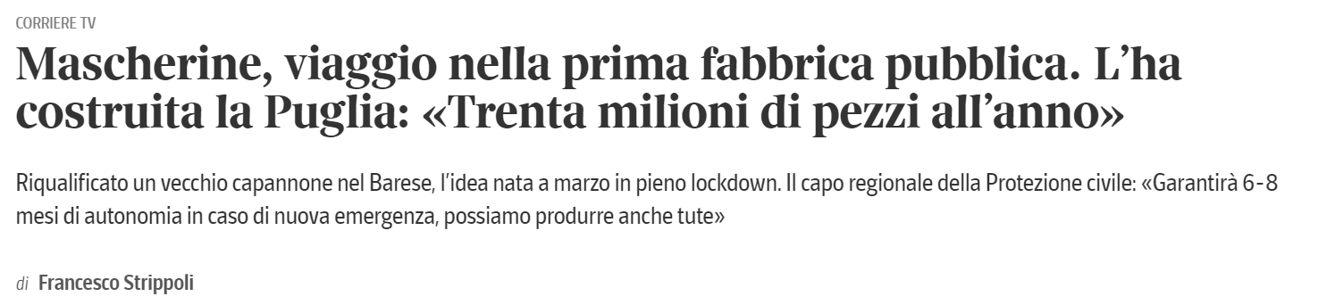
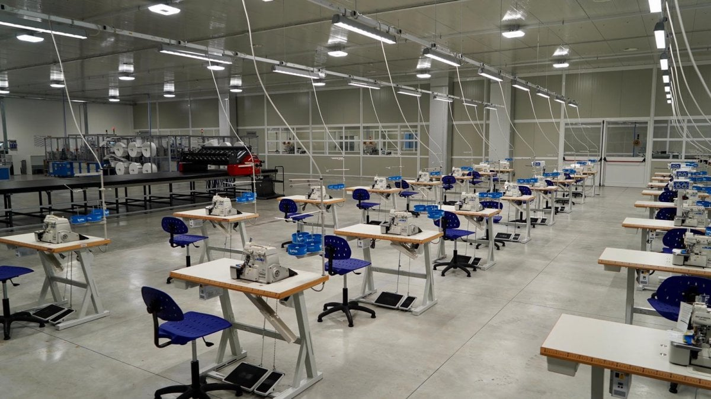
Practical Example (3)
Expensive outsourcing contracts
Converting existing production capacity to serve local needs

Slide 18
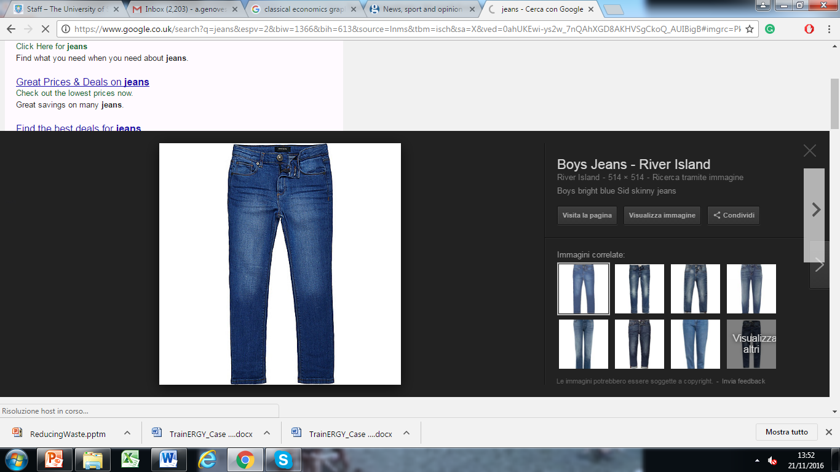
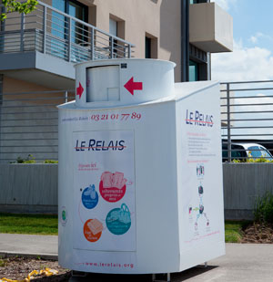
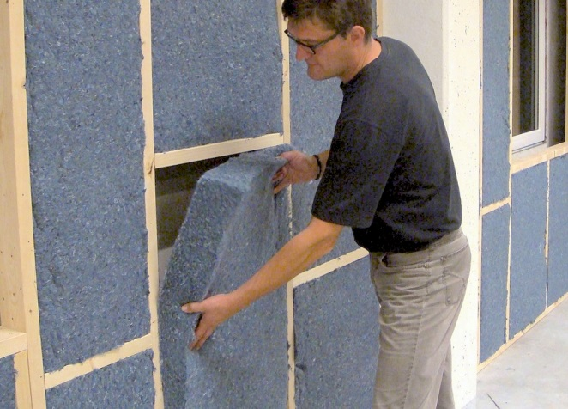
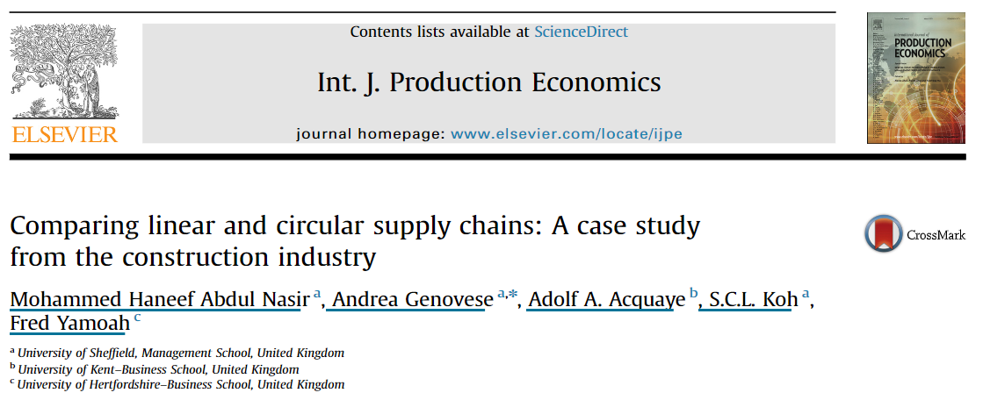
Practical Examples (4)
Video
Results Published in: Nasir, M. H. A., Genovese, A., Acquaye, A. A., Koh, S. C. L., & Yamoah, F. (2017). Comparing linear and circular supply chains: A case study from the construction industry. International Journal of Production Economics, 183, 443-457.

Slide 19
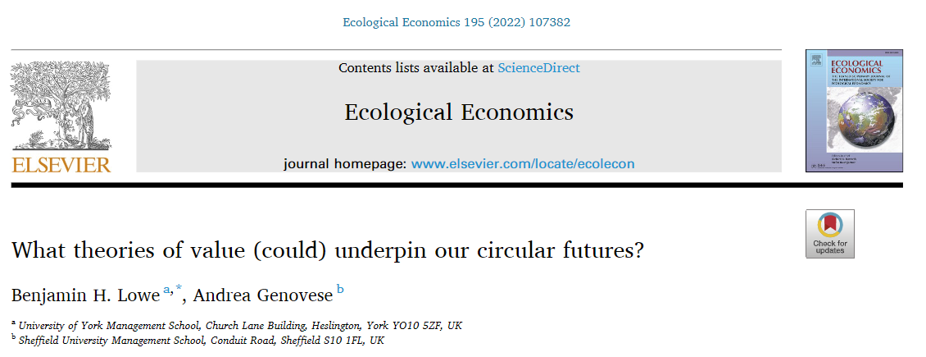
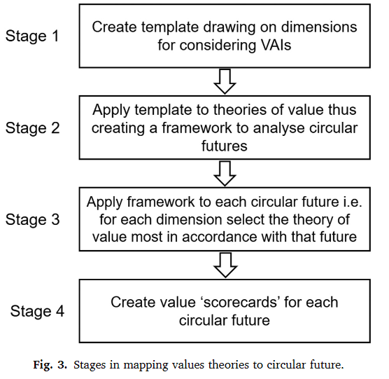
Circular Futures and Value
Circular futures are value articulating institutions that implicitly adhere to a conception of value even if this is not explicitly acknowledged
CE research has so far ignored value theory given that this goes to the heart of how societies evaluate trade-offs between environmental, social and economic goals

Slide 20
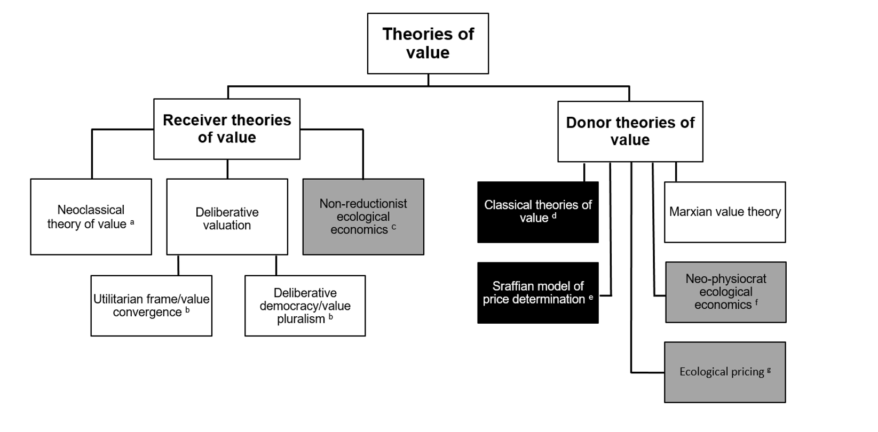
Heterodox and Mainstream ToVs
Source: Lowe and Genovese (2022)

Slide 21
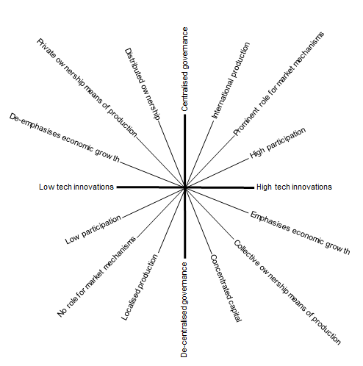
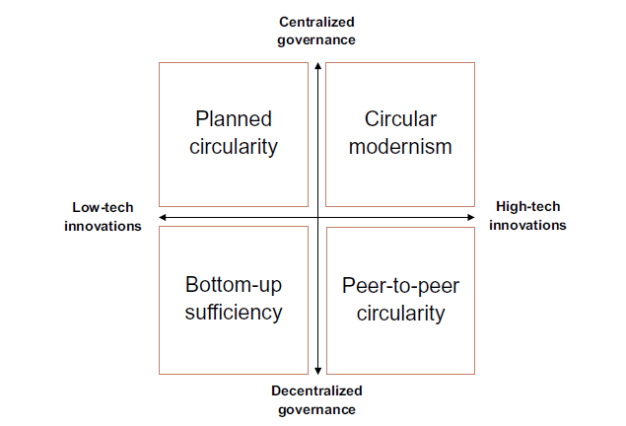
Circular Futures
Source: Bauwens et al. 2020
Source: Lowe and Genovese (2022)

Slide 22
CE Futures and TOVs
2) Planned circularity
1) Circular modernism
‘Invisible hand’ supplanted to varying
degrees by planning & coordination ⸫ cost of
production TOV particularly relevant
a) planning still involves a role for the market
Sraffa’s model of price determination
b) command economy with no role for market
TOV based on physical calculations
Focus on economic growth, market forces,
high-consumption lifestyles and technology.
Likely role for non-market valuation
Neoclassical price theory
Marxian TOV (for transformational purposes)
3) Bottom-up sufficiency
4) Peer-to-peer circularity
Localised production and a significant
reduction in consumption
Deliberative democracy
Political and economic relocalisation through
decentralization of decision making
Deliberative democracy
Less optimistic about role of technology – focus
on resilience and long term perspective
Non-reductionist EE
Depends on the nature of servitisation platforms:
a) based on platforms that are community-owned
and which promote truly collaborative consumption
Deliberative approaches
b) characterised by ‘platform capitalism’
(Uber, Amazon, AirBnB)
Neoclassical price theory

Slide 23
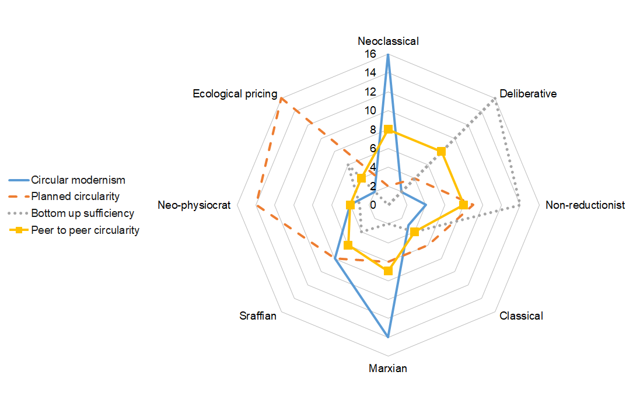
CE Futures and TOVs

Slide 24
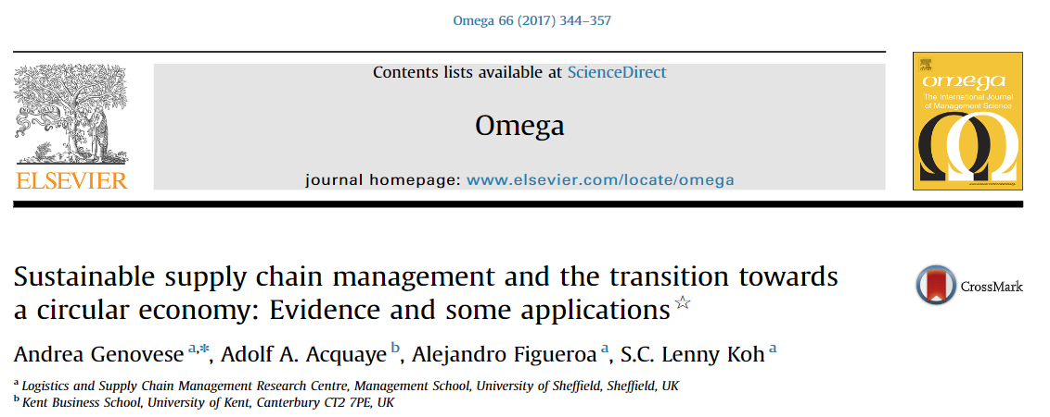
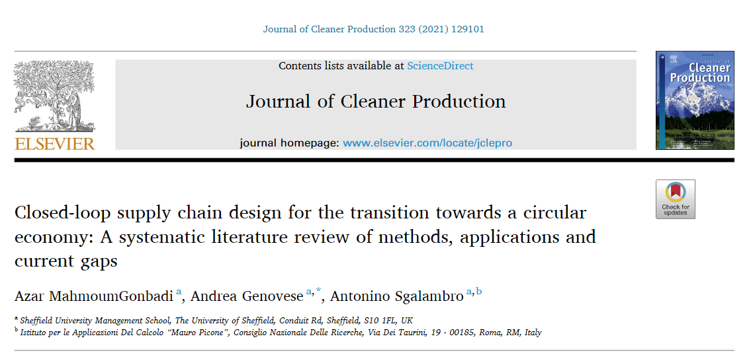
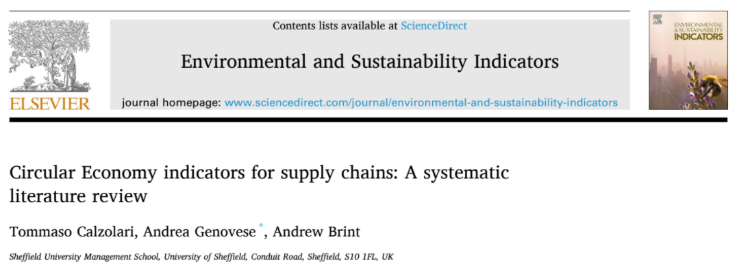
CE Futures and Supply Chains
The focus on CE modernism and Neoclassical ToV is apparent in the Supply Chain Management literature
Supply Chains are acknowledged as a building block for the transition towards a CE
The literature is just focused on low R-imperatives (reduce and refuse are completely overlooked – perennial growth is taken as the horizon)
The social dimensions are missing (or superficially considered)
“Neoclassical” and “receiver side” indicators are employed; bio-physical measures are overlooked
Lack of truly multi-criteria and multi-stakeholder assessments

Slide 25
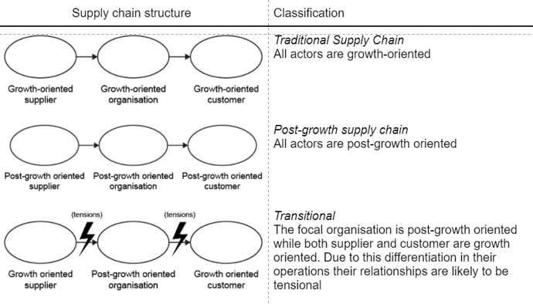
CE Futures and Supply Chains
Time to rethink supply chains?
Extending post-growth ideas to SCM domain?

Slide 26
Conclusions
CE has become a popular buzzword
Almost an empty signifier, but it mobilises powerful concepts
  Waste is a visible by-product of capitalism
  Waste has generated visible crises
My take: let’s not drop it; let’s repoliticise it

Slide 27


Our Initiatives
Forthcoming:
  More projects
  Special Issues
  Dialogue with Trade Unions and political movements

Slide 28
Thank You!
Questions?
Comments?

Slide 29
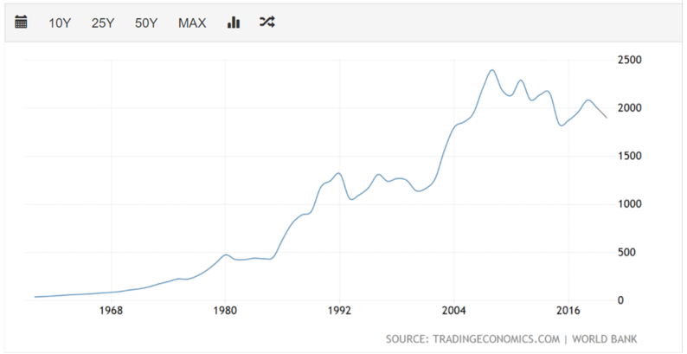
Appendix
Is growth achievable?

Slide 30
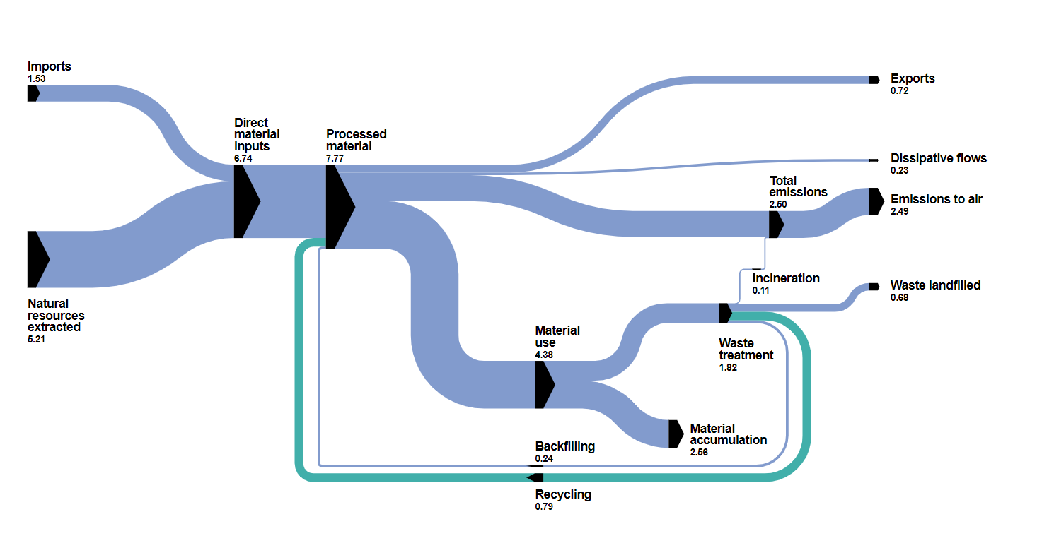
Appendix
This Sankey diagram shows the flows of materials as they pass through the EU economy and are eventually discharged back into the environment or re-fed into the economic processing.
Material flows true scale in Gt/year (billion tonnes per year), EU, 2020. Source: Eurostat

